Slide 1

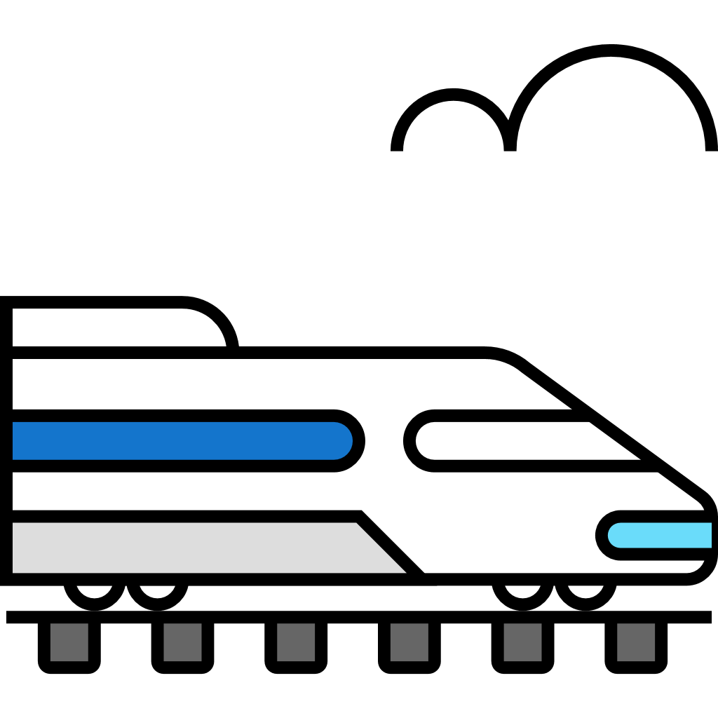
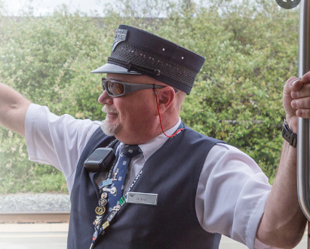



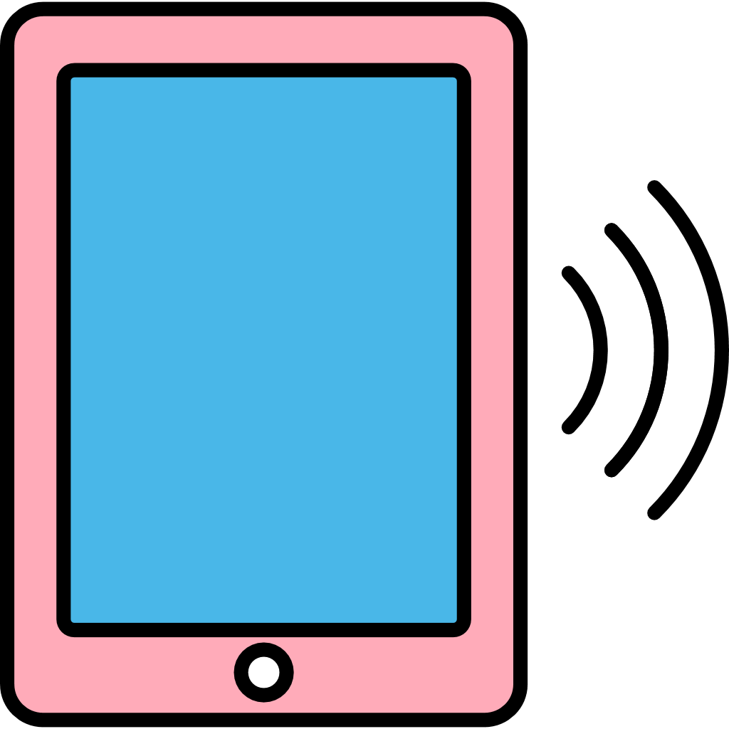


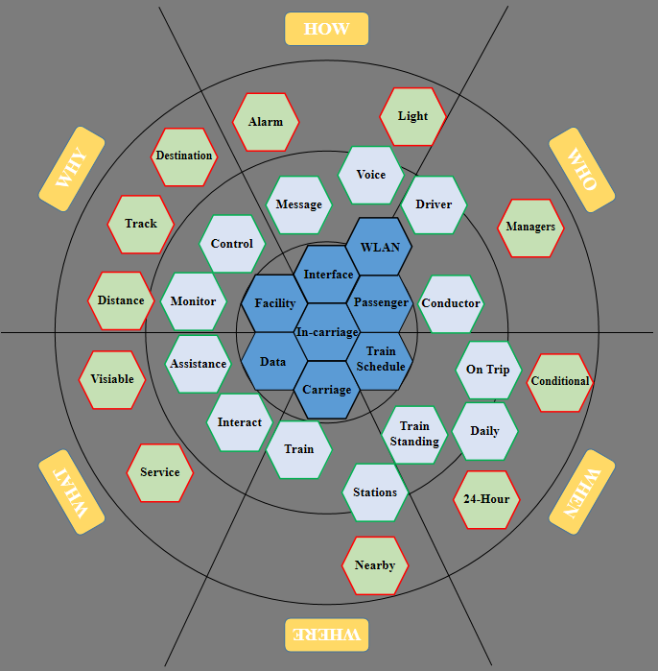


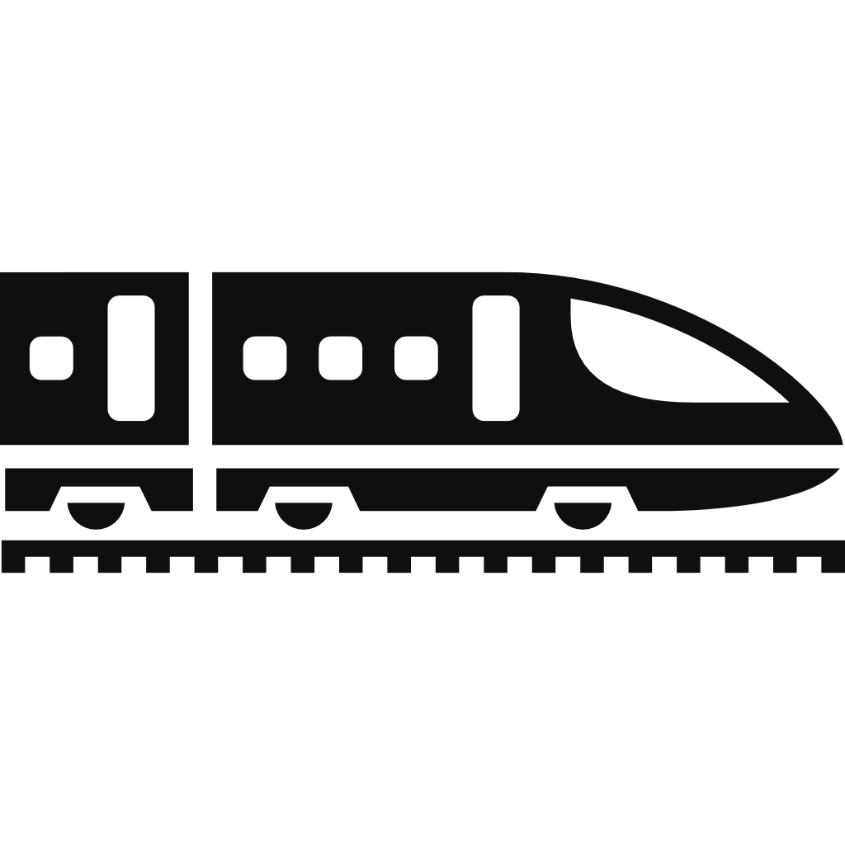







IN-CARRIAGE MULTI-USER CONTROL SYSTEM
INTRODUCTION
CREATED BY: GROUP D
MEMBERS:
ZHAOQI CHEN
SHAHBAAZ HUSSAIN
CHENGWEI JIAO
LAYEK AHMAD
IN-CARRIAGE MULTI-USER CONTROL SYSTEM is a functional design for train manufacturers and facilitates multiple users to monitor and control in-carriage devices. The system is deployed on trains and is visible by using matched smart phone application, as well as supporting two types of modes according to different account identities, including TRAIN STAFF and PASSENGERS.
RICH PICTURE
PERSONAS-CONDUCTOR
PERSONAS-PASSENGER
Enough function?
Design of
Application & Train
Marketing and Profit
Privacy?
Security?
Real-time control?
Use-friendly?
Oren
- age 54
- train conductor with more
than 25 years exp
- familar with various services
- hard of moving fast
- hard of hearing clearly
Amy
- age 30
- investment manager
- often errand by train
- disabled
- wheelchair is necessary
Train
Sensor, Circuit, and Physical system
Manufacturer
Design and product the train and software application on smart phone.
Passenger
Work, Travelling, Hobbies and Familiarity with smart phone.
Scenarios
Scenarios
Multi-functional?
Convenient?
Use-friendly?
Safety?
Sensitive?
Use-friendly?
One day, oren was informed by driver that there was a door not closed when the train was already to depart. He started to find the target door immediately, but it still cost several minutes for him to check the doors one by one. A short delay happened because of the emergency.
Amy ofen need to takes a train to meet the client of her company in person. “It is a challenge for me to press the control button on a high position.” Amy said, “So I always follow other passengers. However, sometimes I have to ask for help when I am the only one to get off the train, which is not convenient.”
Smart Phone
(System application)
Driver
Driving experience, Hobbies
Conductor
Working experience, Activities
REQUIREMENTS
ECOLOGY MAP
Train Staff (driver/conductor) | Staff should be able to monitor and control doors (both single and all). Staff should be able to monitor and control the carriage lights. Staff should be able to locate the passenger when they receive a service request. Staff should be able to activate the carriage destination board.
Passengers | Passengers should be identified with their seat numbers. Passengers should be able to open/close the door of their carriage when the train arrives. Passengers should be able to call train staff for help. Passengers should be able to apply for stopping train in an emergency.
NAVIGATION MAP
Loginpage
Homepage
Driving Speed
Distance to Next Station
REFERENCES
Passengers
Door Icon
(single)
Emergency Report
Call for Help
Adam Straughan - Train Driver - London North Eastern Railway | LinkedIn. (2020, February 3). https://uk.linkedin.com/in/adam-straughan-43306934
Brodsky, J. (2021, November 13). Why It Pays To Train And Hire People With Disabilities. Forbes. https://www.forbes.com/sites/juliabrodsky/2021/11/13/why-it-pays-to-train-and-hire-people-with-disabilities/?sh=2230f7cf7900
Meet Oren: Employees at Amtrak. (n.d.). Retrieved October 28, 2022, from https://careers.amtrak.com/
content/Meet- Oren/?locale=en_US
Staff
Door Icon
(all)
Light Icon
Carriage Destination Board
Message
MOCK UP - PASSENGER MODEL
MOCK UP - STAFF MODEL
next station: Aberdeen
① Rolling bar - next station
Connecting with destination board
② Rolling bar - train speed and estimated time to next station
Example: [speed: 180km/h, arrive in 25 mins.]
③ Doors: OPEN/CLOSE (Button)
Passengers are able to switch the state of door between open and close when it is safe. Safe: When the train is standing on a station, and a same door is not allowed to operate too frequently.
④ Toilet: Occupied/Vacant
⑤ Report (Button)
Allows passengers to send train staff (conductors) message when they need help. (eg facility trouble, ordering goods)
⑥ Emergency (Button)
Allows passengers to call train staff (conductors and even driver) immidiately when there is an emergency. Even allows passengers to stop the train when it is necessary in the emergency.
① Rolling bar - next station (Button)
Staff could change the content of rolling bar (destination board)
② Lights: OPEN/CLOSE (Button)
Staff could control every light in every coach, as well as control them together.
③ Doors: OPEN/CLOSE (Button)
Staff could monitor each door, and could switch each door’s state respective or totally.
Generally, after the train arrives at a station and stops down, driver could open all doors together.
④ Message (Button)
When passengers need help, they will send a report, and staff could receive the message. As well as locating the sender’s seat.
⑤ Emergency (Button)
When passengers are in emergency, staff could receive alarm, which is a phone call in fact.
next station: Aberdeen
1
1
speed: 180km/h, arrive
speed: 180km/h, arrive
O
2
4
3
C
2
COACH 1
C
3
2
COACH 2
3
2
COACH 3
3
2
COACH 4
3
V
3
O
2
COACH 5
O
3
5
4
6
2
COACH 6
3
REPORT
EMERGENCY
4
5
MESSAGE
EMERGENCY

